Slide 1
Final Project Presentation
Phishing Site Detection

Slide 2
Student Details
Sl.No. | Reg. No. | Name of the student | Department
1 | 18ETCS002068 | M C Dharshini | CSE
2 | 18ETCS002075 | Mydur Manishkumar | CSE
3 | 18ETCS002076 | Naveen Kumar R C | CSE
4 | 18ETCS002095 | Rayanagoud Nadagoudra | CSE
5 | 18ETCS002100 | Rohith N | CSE
Batch: 2018

Slide 3
Title of the Project
Phishing Site Detection
Proposed Supervisors
Supervisor 1: Ms Pallavi R Kumar
Supervisor 2:
Proposed Place of Work
M S Ramaiah University of Applied Sciences

Slide 4
Outline
Title and Aim
Introduction
Motivation(Project Concept and its relevance)
Objectives
Approach
Methods and Methodology
Block Diagram
Model evaluation
Results
Conclusion
Future scope
Gantt chart
Cost Estimation
References

Slide 5
Title and Aim
Title
Phishing Site Detection
using Machine Learning
Aim
This website is develop for identify the safety of URL.

Slide 6
Introduction
The Internet has become an indispensable part of our life, However, It also has provided opportunities to anonymously perform malicious activities like Phishing. Phishers try to deceive their victims by social engineering or creating mockup websites to steal information such as account ID, username, password from individuals and organizations. Although many methods have been proposed to detect phishing websites, Phishers have evolved their methods to escape from these detection methods. One of the most successful methods for detecting these malicious activities is Machine Learning. This is because most Phishing attacks have some common characteristics which can be identified by machine learning methods.

Slide 7
Motivation
Detection and prevention of phishing websites endure measure continuously a major space for analysis. There are different types of phishing techniques that offer torrential and essential ways that offer attackers to penetrate the data of people and organizations. Uniform resource locator URLs sometimes are also referred to as “Weblinks” play a vital role in a phishing attack.
Uniform resource locator has a vulnerability of redirecting the pages i.e., through the hyperlink, which could redirect to the legitimate website or the phishing site. Different techniques in making phishing sites are emerging day by day. This actually motivated several researchers to put up their concentrate on finding the phishing sites.

Slide 8
Objectives
The objective of this project is to train machine learning models and deep neural nets on the dataset created to predict phishing websites. Both phishing and benign URLs of website are gathered to form a dataset and from them required URL and website content-based features are extracted. The performance level of each model is measures and compared.
Utilize technologies like:
Python modules
-pandas, scikit learn, numpy, flask.
Machine learning algorithm
- Classification, Regression
HTML, CSS

Slide 9
Approach
Collect dataset containing phishing and legitimate websites from the open source platform.
Write a code to extract the required features from the URL database.
Analyze and preprocess the dataset by using EDA techniques.
Divide the dataset into training and testing sets.
Run selected machine learning and deep neural network algorithm like multilayer perceptron, Random forest, Decision tree on the dataset.
Write a code for displaying the evaluation result considering accuracy metrics.
Compare the obtained results for trained models and specify which is better.

Slide 10
Methods and Methodology
Loading data
A collection of website URLs for 11000+ websites. Each sample has 30 website parameters and a class label identifying it as a phishing website or not (1 or -1).
The data set also serves as an input for project scoping and tries to specify the functional and non-functional requirements for it.
Familiarizing with Data
In this step, few dataframe methods are used to look into the data and its features. It is helpful in checking if there is any missing value in dataset and to check if there is any outliners present in the dataset.

Slide 11
Methods and Methodology Contd.
Visualizing the data
Few plots and graphs are displayed to find how the data is distributed and the how features are related to each other.
Splitting the Data
Both training and testing stage is very important in preparing the best model here we used 80% of data to train the model and 20% to test the model.

Slide 12
Methods and Methodology Contd.
Machine learning models
This dataset comes under classification problem, as the input URL is classified as phishing(1) or legitimate(0). The machine learning models considered to train the dataset in this notebook are:
Logistic Regression
K-nearest Neighbour
Support vector classifer
Naïve Bayes
Decision tree
Random forest
XGBoast classifer
Multilayer Perceptron

Slide 13
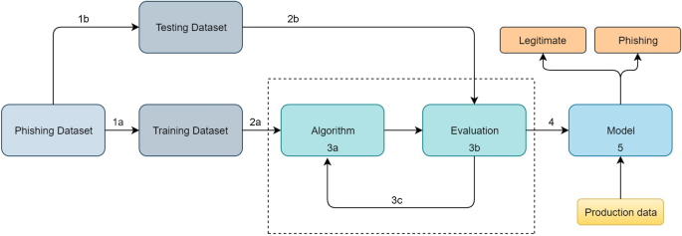
Block Diagram

Slide 14
Model Evaluation
The models are evaluated and considered metric is accuracy.
Below figure shows the training and test dataset accuracy by the respective models.
SL. No | Machine Learning Model | Train Accuracy | Test Accuracy
1 | Logistic Regression | 0.927 | 0.934
2 | K-nearest Neighbour | 0.989 | 0.956
3 | Support Vector classifer | 0.969 | 0.964
4 | Naïve Bayes | 0.605 | 0.605
5 | Decision tree | 0.991 | 0.960
6 | Gradient Boasting Classifer | 0.989 | 0.974
7 | Random Forest | 0.991 | 0.967
8 | Catboast | 0.991 | 0.972
9 | XGBoast Classifer | 0.987 | 0.969
10 | Multilayer Perceptron | 0.986 | 0.969

Slide 15
The Main Benefit of a Phishing site detection
The purpose of this project is to design an intelligent system for detecting phishing websites.
Providing the safety to the user by avoiding the cyber attacks.
Eliminate the cyber threat risk level.
Increase user alertness to phishing risks.
Instill a cyber security culture and create cyber security heroes.
Change behavior to eliminate the automatic trust response
Assess the impacts of cyber security awareness training

Slide 16

Results

Slide 17
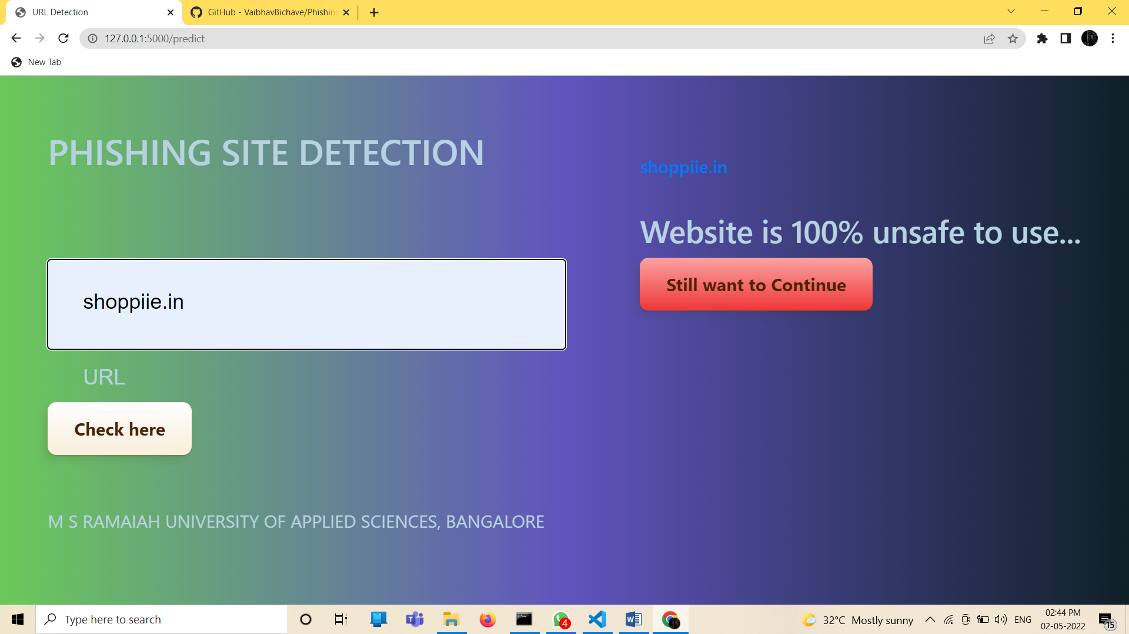
Results

Slide 18

Results

Slide 19
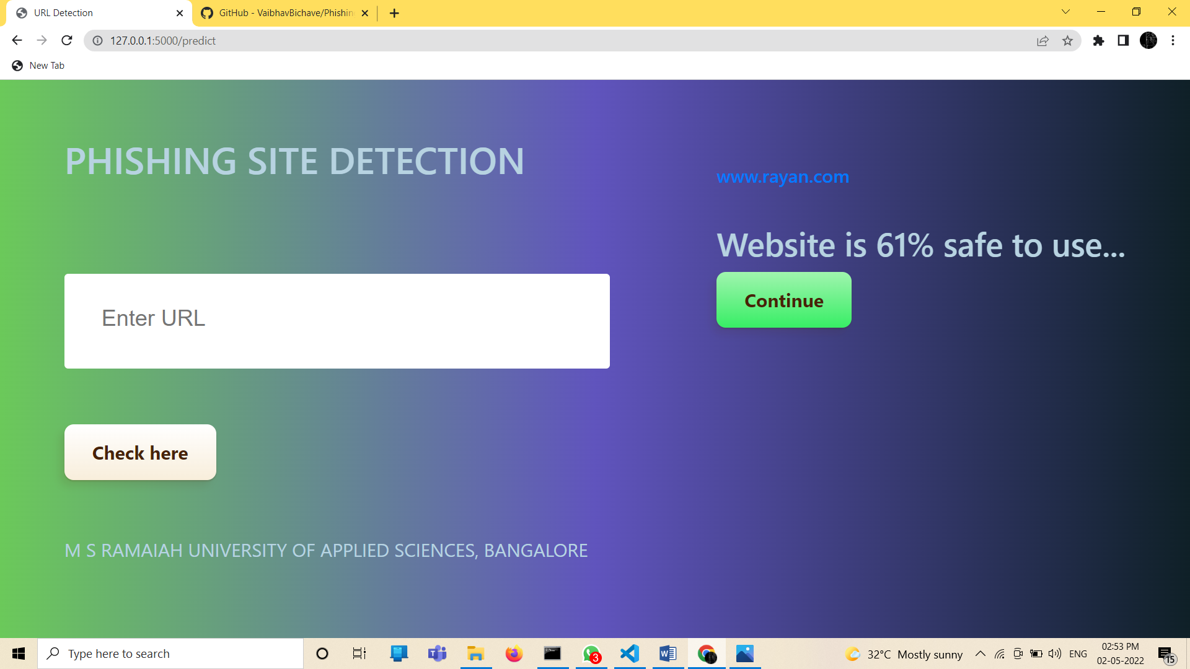
Results

Slide 20
Conclusion
The final take away form this project is to explore various machine learning models, perform Exploratory Data Analysis on phishing dataset and understanding their features.
The final conclusion on the Phishing dataset is that the some feature like "HTTTPS", "AnchorURL", "WebsiteTraffic" have more importance to classify URL is phishing URL or not.
This project aims to enhance detection method to detect phishing websites using machine learning technology. We achieved 97.4% detection accuracy using Gradient Boasting Classifer algorithm with lowest false positive rate and hence reduces the chance of malicious attachments. Also result shows that classifiers give better performance when we used more data as training data.

Slide 21
Future Scope
This is what we get after our phishing detection, when we check the tested url ,we don’t get redirected to the corresponding site as it shows spelling mistake.

Slide 22
Gantt Chart
Project Work (UG) 12 weeks
Week | 1 | 2 | 3 | 4 | 5 | 6 | 7 | 8 | 9 | 10 | 11 | 12
Major Activities
1. Overview
2. Motivation
3. Approach
4. Method and Methodology
5. Model Evaluation
6. Conclusion

Slide 23
Cost Estimation
Serial Number | Resources and Work | Cost(Rs)
1 | Laptop (for development) | 30,000/-
2 | Human Resources (5 * 5,000) | 25,000/-
 | TOTAL | 55,000/-
Man hours:
Man hours per week (students): 10 *5 students =50
Man hours per week (faculty): 3

Slide 24
References
The dataset is borrowed from Kaggle, https://www.kaggle.com/eswarchandt/phishing-website-detector
Kulkarni, Arun D. and Brown,, Leonard L. III, "Phishing Websites Detection using Machine Learning" (2019). Computer Science Faculty Publications and Presentations. Paper 20. http://hdl.handle.net/10950/1862
Hossein Shirazi, Kyle Haefner, Indrakshi Ray: Fresh-Phish: A Framework for Auto-Detection of Phishing Websites: In (International Conference on Information Reuse and Integration (IRI)) IEEE,2017.
Ankit Kumar Jain, B. B. Gupta : Towards detection of phishing websites on client-side using machine learning based approach :In Springer Science+Business Media, LLC, part of Springer Nature 2017

Slide 25
References
Bhagyashree E. Sananse, Tanuja K. Sarode : Phishing URL Detection: A Machine Learning and Web Mining-based Approach : In International Journal of Computer Applications,2015
Y. Zhang, J. I. Hong, and L. F. Cranor, Cantina:A Content-based Approach to Detecting Phishing Web Sites, New York, NY, USA, 2007,pp. 639-648.
Hassan Y.A.Abutair, AbdelfettahBelghith, Using Case-Based Reason- ing for Phishing Detection, in 2017 .The 8th International Conference on Ambient SystemsNetworks and Technologies(ANT) 2017,pp.281- 288.L.
Breiman, Random Forests, Machine Learning, vol.45, no. 1, pp.5-32, Oct. 2001.
Sirageldin, B. B. Baharudin, and L. T. Jung, Malicious Web Page Detection: A Machine Learning Approach, in Advances in Computer Science and its Applications, Springer, Berlin, Heidelberg, 2014, pp.217- 22

Slide 26
Thank You!

